Slide 1
Programming Fundamentals
By
Shazmeen Batool

Slide 2
Lab Task 1
Print Diamond using escape sequence “\n” and “\t”? In single cout statement?\
Output should be like:
*
* * *
* * * * *
* * *
*

Slide 3
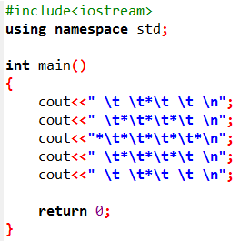
Program

Slide 4
Lab Task 2
Print your Result Card using required escape sequences? Print all other information as it is but get input from user in obtained marks and calculate the percentage of entered marks?
Result Card
Name: ABC Reg.No# --------------
Session: Fall-23 Semester: 1
Subjects Total Marks Obtained Marks
Programming Fundamentals 100 ___user input___
Applied Physics 100 ___user input___
Pakistan Studies 100 ___user input___
Percentage= %

Slide 5
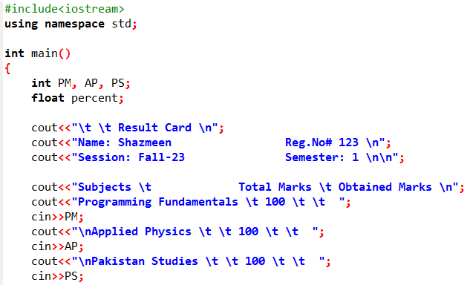
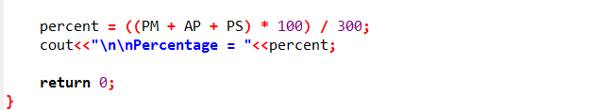

Slide 6
Lab Task 3
A parking plaza assigns slot numbers to cars.
The parking slots start from 0.
When a car enters, the slot number should increase by 1 using the increment operator.
When the car leaves, the slot number should decrease by 1 using the decrement operator.

Slide 7
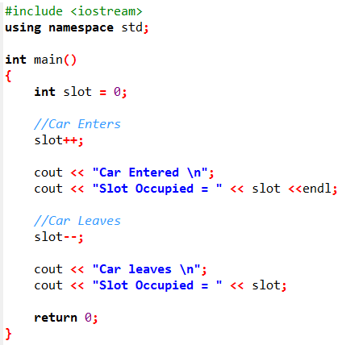


Slide 8
Lab Task 4
Write a C++ program that tells the user that the number entered is less than or greater than 10?

Slide 9
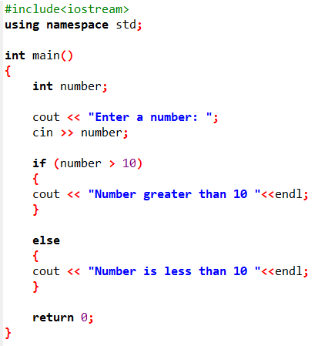


Output 1:
Output 2:

Slide 10
Lab Task 5
Write a C++ program that tells the user that the number entered is even or odd?

Slide 11
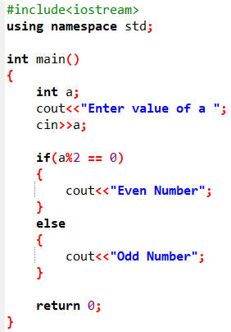

Slide 12
Lab Task 6
Write a program that calculates a sales commission based on sales amount. Ask the user to enter sales amount, if sales exceed $10,000, set the commission rate to 15% (0.15); otherwise, leave it at the default 10% (0.10). Then, compute and display the commission.

Slide 13
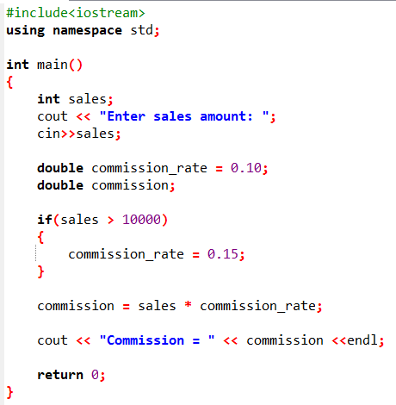


Slide 14
Lab Task 7
Write a complete C++ program that performs the following tasks:
Prompts the user to enter three integer test scores (each between 0 and 100).
Calculates the average of the three scores as a floating-point value (use 3.0 in the denominator to ensure decimal precision).
Displays the average score.
If the average is greater than or equal to 90, prints three congratulatory messages:
"Congratulations!“
"That's a high score.“
"You deserve a pat on the back!“
Otherwise, prints a single message: "Keep studying!"

Slide 15

